Slide 1
MARKET SALES PREDICTION
CAPSTONE PROJECT
Presented By:
SANJAY PRAMANIK
Noida Institute of Engineering and Technology(NIET)
Computer Science & Engineering(AI)

Slide 2
OUTLINE
Problem Statemen
Proposed System/Solution
System Development Approach
Algorithm & Deployment
Result
Conclusion
Future Scope
References

Slide 3
Problem Statement
In a competitive business environment, understanding sales trends and customer behavior is crucial. The company has accumulated vast amounts of sales data over the years. However, this data has not been fully utilized to its potential. Analyzing this data can uncover valuable insights that can inform strategic decisions, optimize marketing efforts, and ultimately drive revenue growth.
The company faces challenges in effectively utilizing its extensive sales data to inform strategic decisions. Key issues include:
Data Disparity: Sales data is scattered across various platforms and formats, leading to difficulties in consolidation and analysis.
Trend Detection: Identifying significant trends and patterns within the data is complex, hindering the ability to forecast sales and respond to market changes.
Customer Insights: There is a lack of detailed understanding of customer segments and their purchasing behaviors, affecting the precision of targeted marketing efforts.
4. Performance Metrics: There is a need for robust performance metrics to evaluate the effectiveness of . sales strategies and marketing campaigns.

Slide 4
Proposed Solution
Data Collection: Gather extensive sales data from various sources, ensuring the dataset is comprehensive and includes all relevant variables.
Data Preprocessing: Clean and preprocess the data to handle inconsistencies, missing values, and ensure that all data is in a suitable format for analysis. This includes removing irrelevant columns, handling null values, and converting data types as necessary.
Exploratory Data Analysis (EDA): Conduct a thorough EDA to understand the underlying patterns and relationships within the data. This step involves generating descriptive statistics, visualizing data distributions, and identifying correlations.
Data Visualization: Utilize powerful visualization tools to create intuitive and informative charts and graphs. This helps in understanding complex data patterns and communicating insights effectively.
Reporting and Insights: Summarize the findings in detailed reports, highlighting key insights and actionable recommendations. This includes identifying high-performing products, customer segments, and geographic regions.
Predictive Analytics: Optionally, incorporate predictive analytics to forecast future sales trends and customer behaviors, allowing for proactive decision-making.

Slide 5
System Approach
The system development approach is structured into distinct phases to ensure a systematic and thorough analysis:
Data Collection and Integration:
Gather data from various sources, ensuring it is comprehensive and relevant.
Integrate data into a unified format for analysis.
Data Preprocessing:
Data Cleaning: Remove irrelevant columns such as 'Status' and 'unnamed1' that do not contribute to the analysis.
Handling Missing Values: Identify and handle missing values appropriately, either by filling them with suitable values or removing the affected records.
Data Type Conversion: Ensure that all numerical values, especially 'Amount', are in the correct data type for analysis.

Slide 6
System Approach
3. Exploratory Data Analysis (EDA):
Descriptive Statistics: Generate summary statistics to understand the central tendency, dispersion, and shape of the dataset's distribution.
Correlation Analysis: Identify relationships between different variables to uncover significant patterns.
Visualization: Create various plots (e.g., count plots, bar plots, histograms) to visually explore the data.
4. Data Visualization:
Gender Analysis: Visualize the distribution of sales by gender to understand gender-specific purchasing behaviors.
Age Group Analysis: Analyze the sales distribution across different age groups, providing insights into age-specific trends.
Geographic Analysis: Identify top-performing states and regions to understand geographic sales patterns.
5. Occupation and Marital Status Analysis:
Examine the influence of occupation and marital status on purchasing behavior.
6. Reporting and Insights:
Compile the findings into detailed reports, highlighting key insights and providing actionable recommendations.

Slide 7
Algorithm & Deployment
Data Preprocessing Algorithm:
Load Data: Import the sales data from the provided CSV file.
Clean Data: Remove irrelevant columns ('Status' and 'unnamed1').
Handle Missing Values: Drop rows with missing values.
Convert Data Types: Convert the 'Amount' column to an integer type.
Exploratory Data Analysis (EDA) Algorithm:
Descriptive Statistics: Compute summary statistics for numerical variables.
Group by Operations: Aggregate data by categorical variables (e.g., gender, age group, state) to identify patterns.
Visualization: Create count plots, bar plots, and other visualizations to explore data distributions and relationships.

Slide 8
Algorithm & Deployment
Example Visualizations:
Count Plot of Gender Distribution: Shows the number of sales transactions by gender.
Bar Plot of Total Sales Amount by Gender: Compares the total sales amount between different genders.
Count Plot of Age Group Distribution with Gender: Displays the distribution of age groups, segmented by gender.
Bar Plot of Total Sales Amount by Age Group: Highlights the total sales amount contributed by different age groups.
Top States by Sales: Identifies the states with the highest number of sales and total sales amount.

Slide 9
Result
The exploratory data analysis and visualizations provide the following insights:
Gender Analysis: Males and females have different purchasing behaviors, with one gender potentially contributing more to the overall sales.
Age Group Analysis: Certain age groups show higher purchasing activity and contribute more significantly to sales.
Geographic Analysis: States like Maharashtra and Uttar Pradesh might be leading in sales, indicating strong market presence or higher customer base in these regions.
Occupation and Marital Status: Occupations like Healthcare and Food Processing might show higher purchasing power, while marital status can also influence purchasing decisions.
Product Category Performance: Certain product categories outperform others in terms of sales, which can guide inventory and marketing strategies.

Slide 10
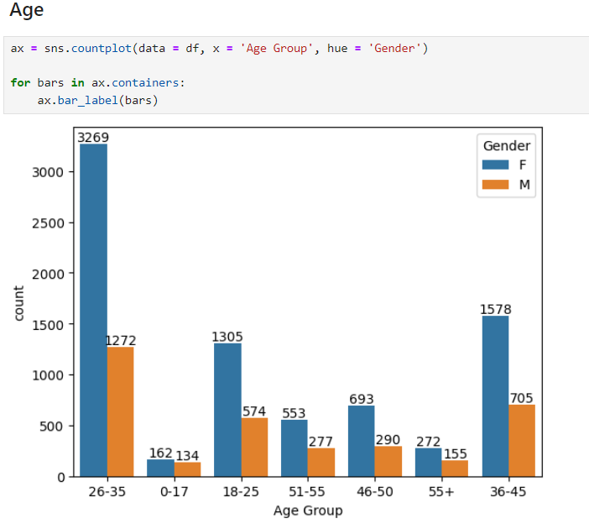
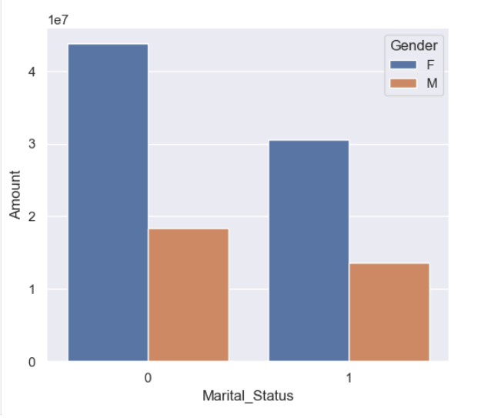
Result
Analysis of age group of male and female.
Purchasing power based on marital status
(most of the buyers are married women and they have high purchasing power

Slide 11
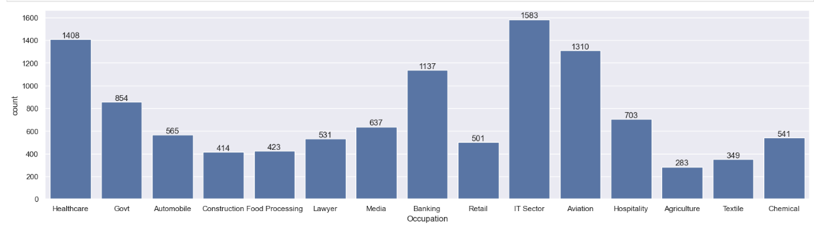
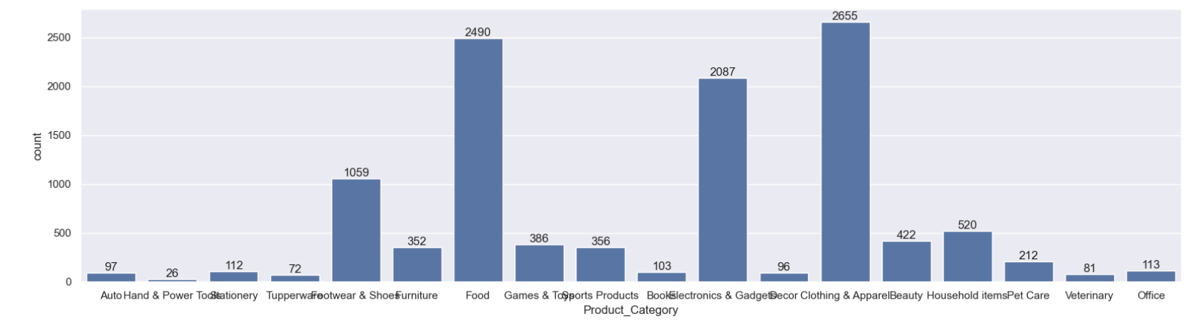
Result
Occupation of people:
Product category:

Slide 12
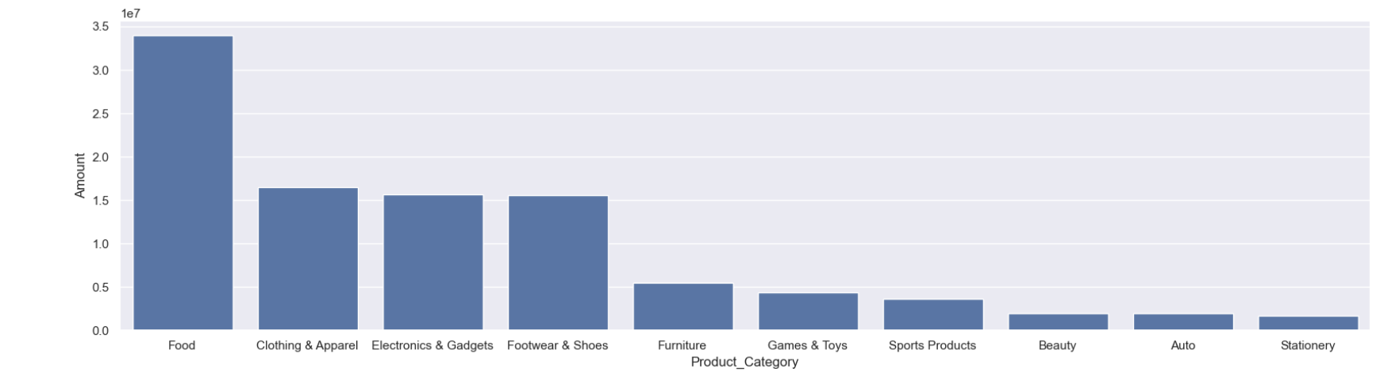
Result
Highest selling Products
From above graphs we can see that most of the sold products are from Food, Clothing and Electronics category.
From the following analysis of various data set it concludes that Married women Age Group: 26-35 years Geographical Location: Uttar Pradesh (UP), Maharashtra, and Karnataka Employment Sectors: Information Technology (IT) Healthcare Aviation Consumer Behavior These women are identified as being more likely to purchase different types of products from the market.

Slide 13
Conclusion
In this project we had data of market sales and after applying the processes to analyse the data of Sale of different products by different peoples based on their interest and profession, we conclude that , The analysis successfully uncovers important trends and patterns in the market sales data. Key findings include gender-specific purchasing behaviors, age group trends, geographic sales distribution, and the impact of occupation and marital status on sales. These insights can be leveraged to refine marketing strategies, optimize inventory, and enhance customer targeting, ultimately driving increased sales and customer satisfaction.

Slide 14
Future scope
Future enhancements to this analysis could include:
Predictive Modeling: Implement machine learning models to forecast future sales trends and customer behaviors based on historical data.
Segmentation Analysis: Perform deeper customer segmentation to target specific groups with tailored marketing campaigns.
Real-Time Analytics: Integrate real-time data analytics to provide up-to-date insights and enable immediate action.
Enhanced Visualizations: Develop interactive dashboards using tools like Tableau or Power BI for more dynamic and user-friendly data exploration.
Additional Data Sources: Incorporate additional data sources such as social media sentiment, economic indicators, and competitor analysis for a more holistic view.

Slide 15
References
McKinney & others, “pandas: powerful Python data analysis toolkit”, 2010.
Hunter, J. D., “Matplotlib: Visualization with Python”, 2007.
Waskom M., “Seaborn: statistical data visualization”, 2021
Pandas Documentation: Pandas Documentation
Official documentation for the Pandas library, which provides extensive tools for data manipulation and analysis.
Seaborn Documentation: Seaborn Documentation
Official documentation for the Seaborn library, which offers advanced visualization capabilities built on top of Matplotlib.
Matplotlib Documentation: Matplotlib Documentation
Official documentation for the Matplotlib library, a comprehensive library for creating static, animated, and interactive visualizations in Python.
Data Analysis and Visualization Libraries: Python Data Analysis Library
Exploratory Data Analysis Techniques: Towards Data Science - EDA

Slide 16

course certificate 1

Slide 17

course certificate 2

Slide 18
THANK YOU

